Slide 1
Family and Friends
WEEK 7

Slide 2
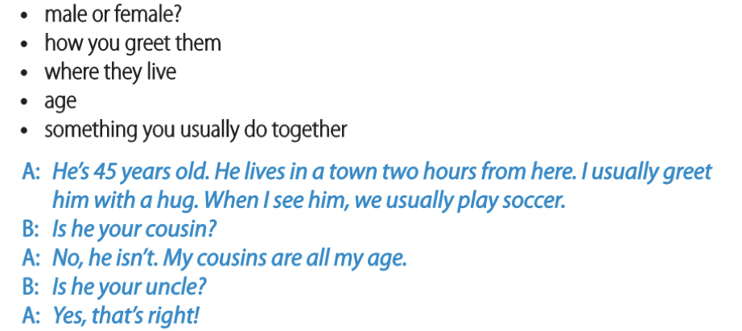
THE PEOPLE IN MY LIFE-GAME
Think of ONE member of your family, but you should not mention who he/she is. Take turns asking questions and try to figure out who your partner is describing.
https://www.youtube.com/watch?v=ceNNH_jnQz8&ab_channel=EasyEnglish

Slide 3
THE PEOPLE IN MY LIFE
Plump
Obsess
Florist
Outfits
Introvert
Carpenter
Real estate
Plump adjective /plʌmp/ having a pleasantly soft, rounded body or shape. (grapes, cheeks, chicken, etc.)
Obsess verb /əbˈses/ to completely fill your mind so that you cannot think of anything else (be obsessed by/with somebody/something)
Florist noun [C] /ˈflɔːr.ɪst/ a person who works in a shop that sells cut flowers and plants for inside the house
Outfit noun [C] /ˈaʊt.fɪt/ a set of clothes worn for a particular occasion or activity
Introvert noun [C] /ˈɪn.trə.vɝːt/ someone who is shy, quiet, and prefers to spend time alone
Carpenter noun [C] /ˈkɑːr.pɪn.t̬ɚ/ a person whose job is making and repairing wooden objects
Real estate noun [U] /ˈriː.əl ɪˌsteɪt/ property in the form of land or buildings

Slide 4
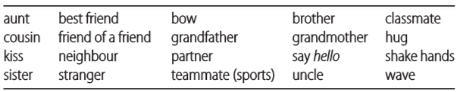
THE PEOPLE IN MY LIFE
Write the words in the correct column. Use a dictionary if necessary. Add one or two words of your own to each column.
FAMILY | OTHER PEOPLE | GREETINGS
aunt
grandmother
classmate
teammates(sports)
bow
shake hands
brother
sister
best friend
partner
hug
cousin
uncle
friend of a friend
kiss
wave
grandfather
stranger
neighbour
say hello

Slide 5
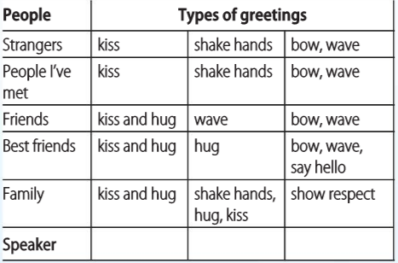
THE PEOPLE IN MY LIFE
The table shows how we greet the people around us. Listen to the podcast and match each column of the table with a speaker. Write the number of the speaker at the bottom.
2-Luiza
3-Hugh
1-Chen
Bow：https://www.youtube.com/watch?v=boQmX6feIn0&ab_channel=ThatJapaneseManYuta

Slide 6
THE PEOPLE IN MY LIFE
Listen again. Choose the correct words.
1. In Chen's family, respect is more important than / isn’t as important as hugs and kisses.
2. Chen's parents talk about / show their love with their actions.
3. Bowing is a way of showing respect / agreement.
4. Luiza doesn't kiss her friends when she says hello / she’s in a hurry.
5. Luiza kisses / doesn’t kiss her sister.
6. Hugh hugs / doesn’t hug his cousins.
7. Hugh always shakes hands with his teachers at school / tennis coach.

Slide 7
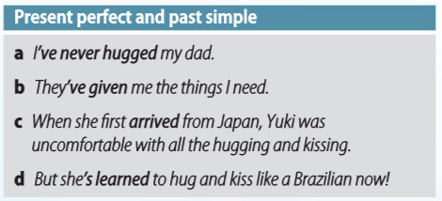
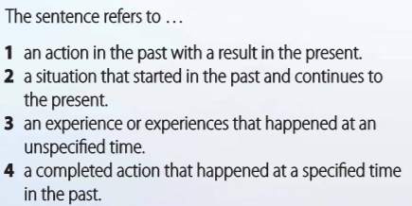
PRESENT PERFECT AND PAST SIMPLE
Look at the Grammar box and read the sentences from the podcast. Match each sentence (a–d) with the best description (1–4).
d
a
b
c

Slide 8
PRESENT PERFECT AND PAST SIMPLE
Choose the correct option to complete each sentence.
1. I took / have taken a few different foreign language courses.
2. Have you ever be / been to Brazil?
3. They’ve always / ever lived in this town.
4. We’ve / We never tried Japanese food in our lives.
5. On our holiday to India last year we met / we’ve met some interesting people.
6. I haven’t travelled / didn’t travel to many different countries.

Slide 9
PRESENT PERFECT AND PAST SIMPLE
Complete the text with the present perfect form of the verbs.
Photographer and anthropologist Emily Ainsworth (1) (travel) the world because she wants to learn about other cultures. She (2) (have) amazing experiences in many different countries, but she says Mexico is very special. 'I (3) (return), and returned again,' she says, adding, 'it (4) (be) my second home.' And the people (5) (welcome) her – at celebrations, family events and even in a circus, where she (6) (perform) as a dancer many times, and continues to do so.
/fəˈtɑː.ɡrə.fɚ/
has travelled
has had
have returned
has been
have welcomed
has performed

Slide 10
PRESENT PERFECT AND PAST SIMPLE
Choose the correct option to complete the text.
Emily was sixteen when she first (1) went / has been to Mexico, and she (2) went / has been back to the country many times. Now she has a lot of friends there. During her visits, she (3) took / has taken pictures of Day of the Dead celebrations and many other important cultural events. At first, she just (4) wanted / has wanted to have photos to remember her trip. But over time, she says, she (5) built / has built – and continues to build – 'relationships with some really interesting people,' and wants to tell their story. As a result, she (6) won / has won several awards for her work.

Slide 11
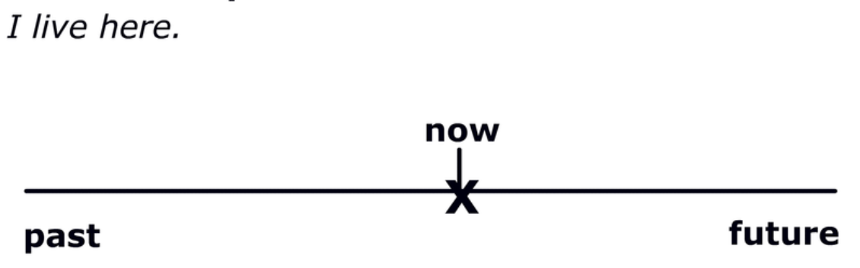
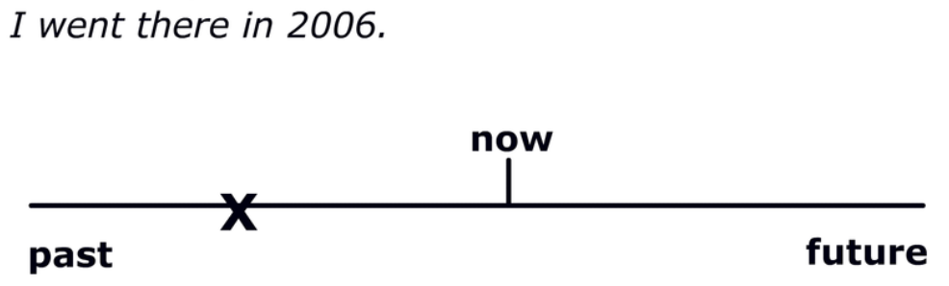
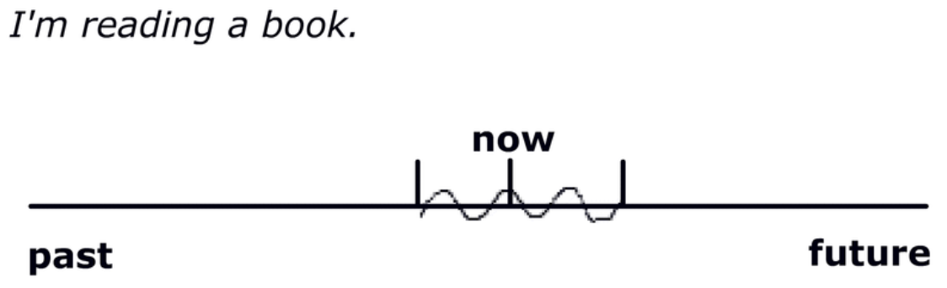
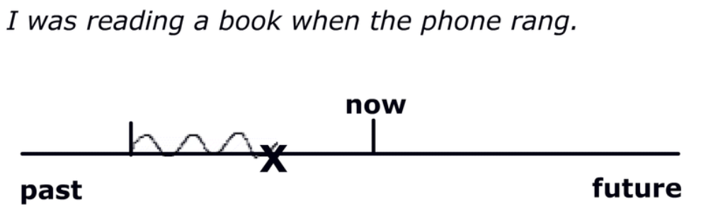
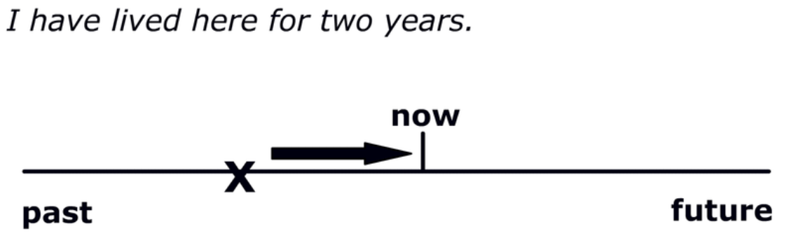
Different tenses so far
Present Simple; Present Continuous; Present Perfect; Past Simple; Past continuous;

Slide 12
Fill in the blanks with the best tense
That food (TASTE) delicious.
He (HAVE) a shower at the moment . You can't disturb him.
He (SLEEP) when we arrived.
Mom and I (WAIT) for over an hour.
I (SEE) what you mean.
The postman came just as I (LEAVE) the house.
At nine o'clock last night I (READ) a book.
What (YOU LOOK) at ? - The sky.
I (NOT DO) anything when the reporter called me.
We (REPAIR) our car all morning, but we're not finished yet.

